Slide 1
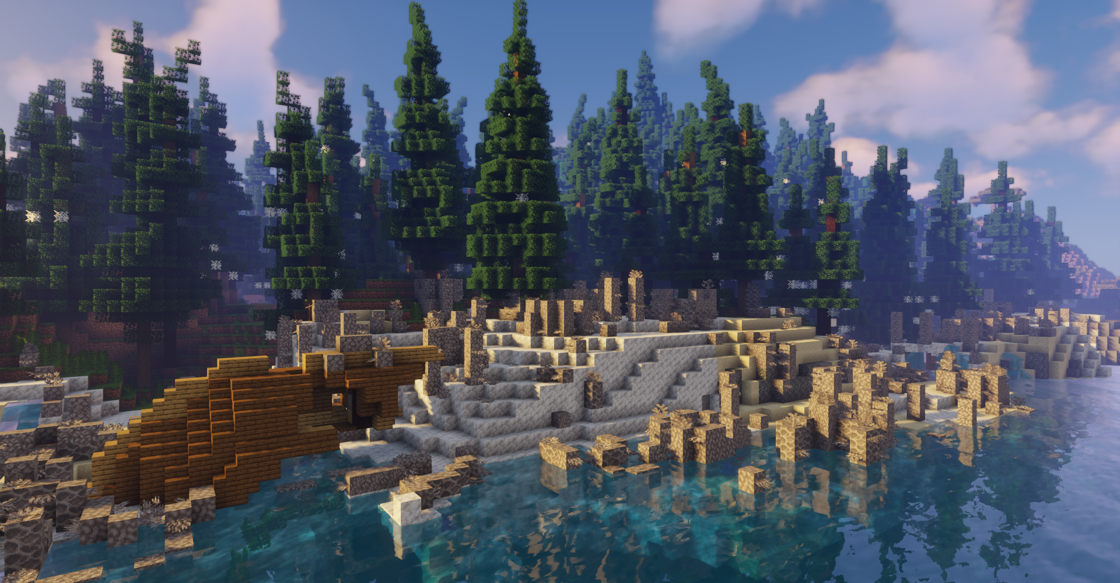


Slide 2
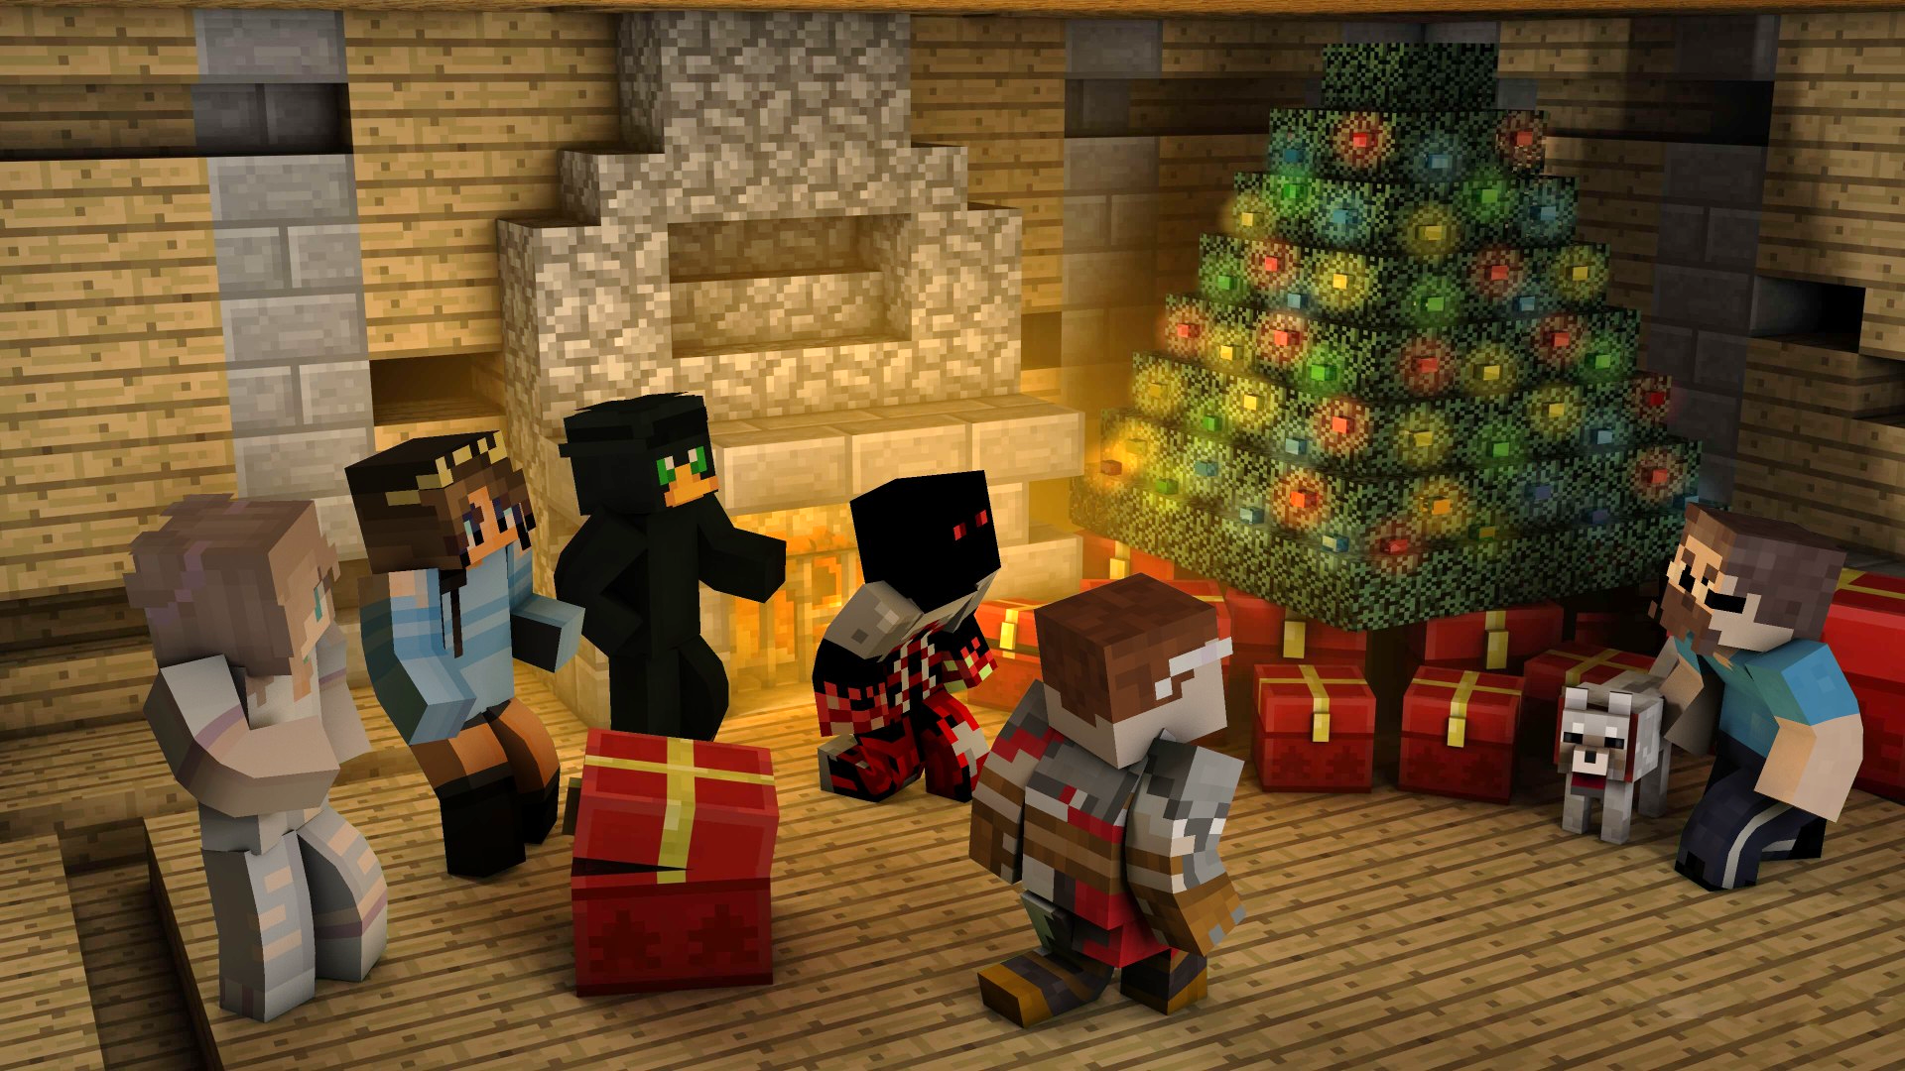



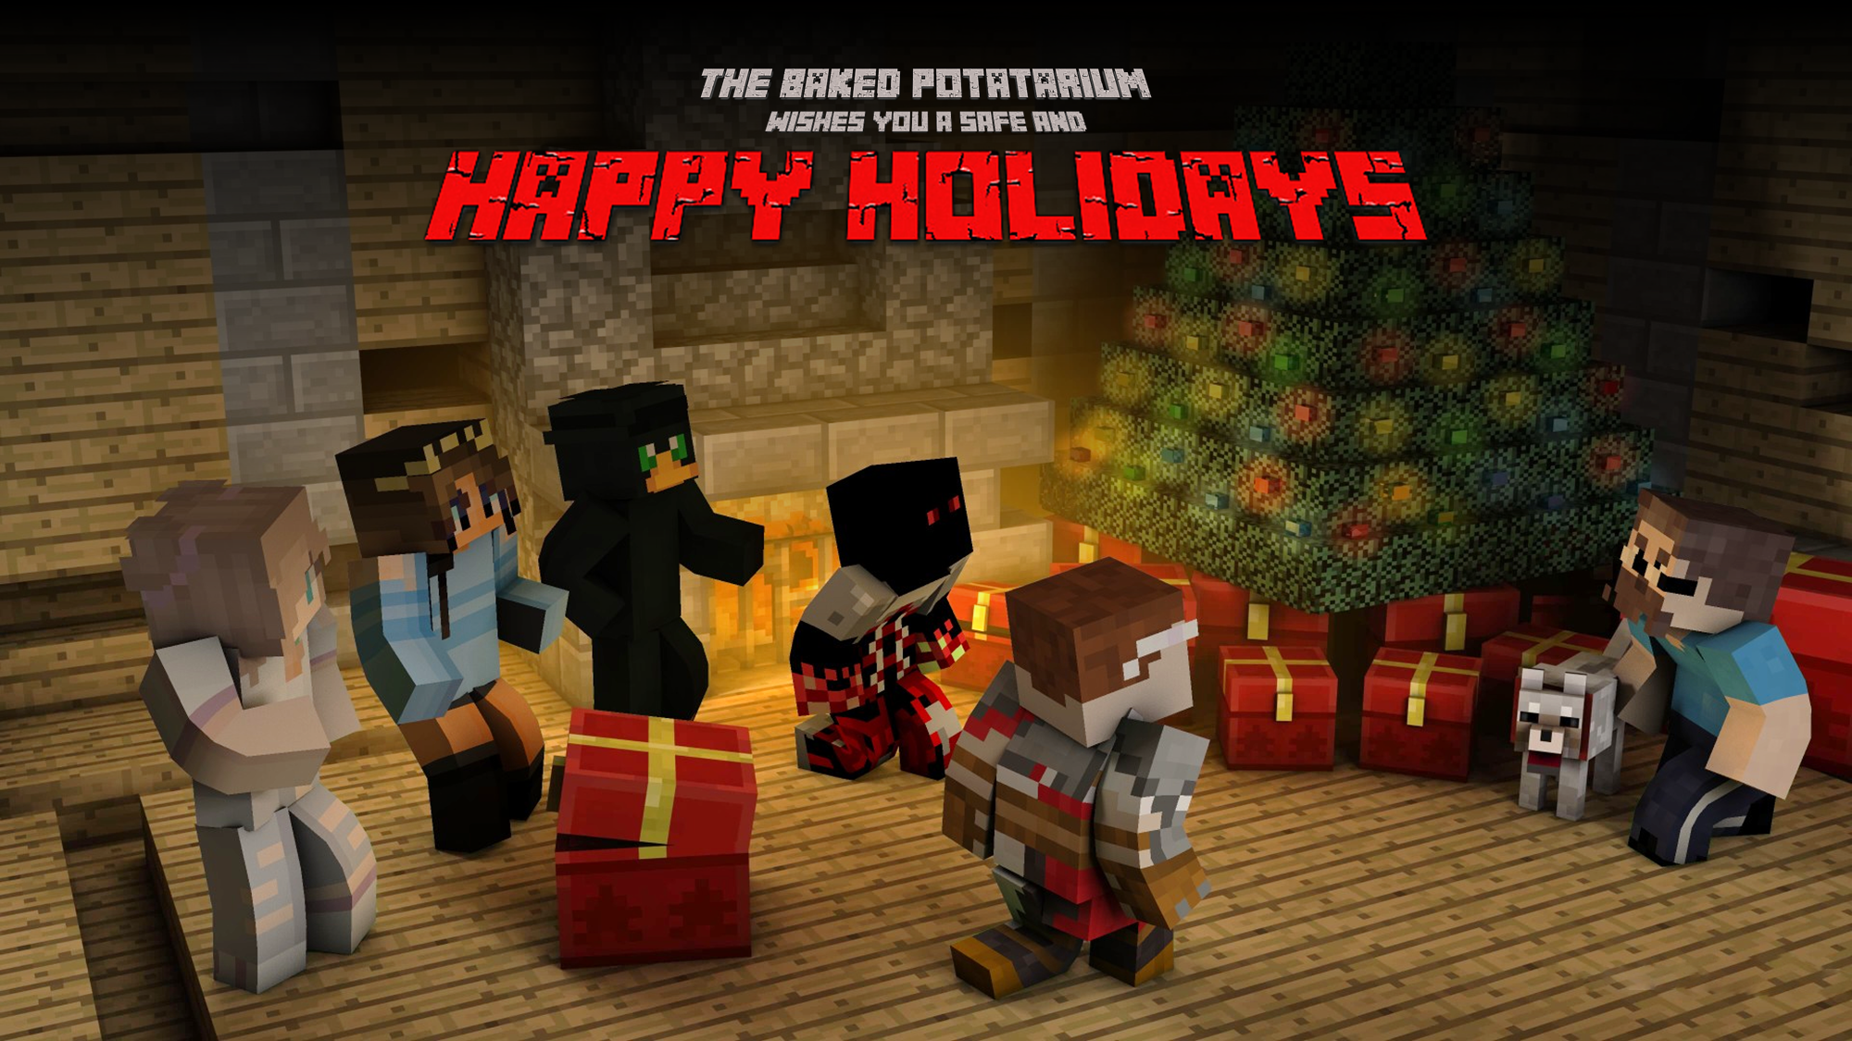

Slide 3




Slide 4
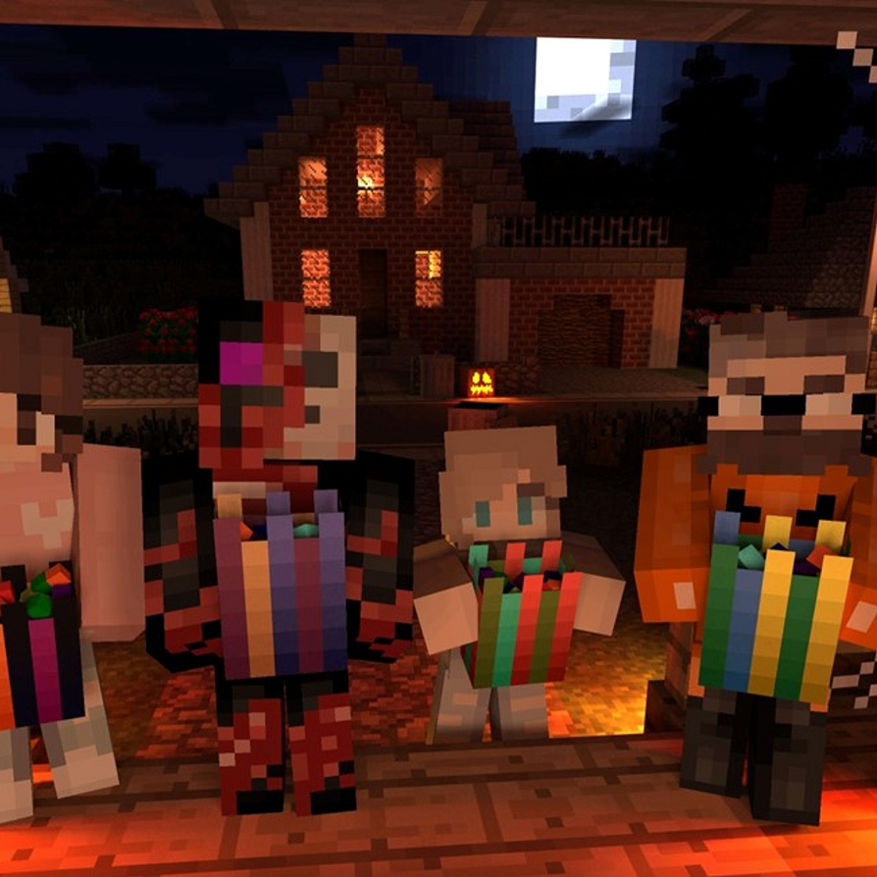


Slide 5
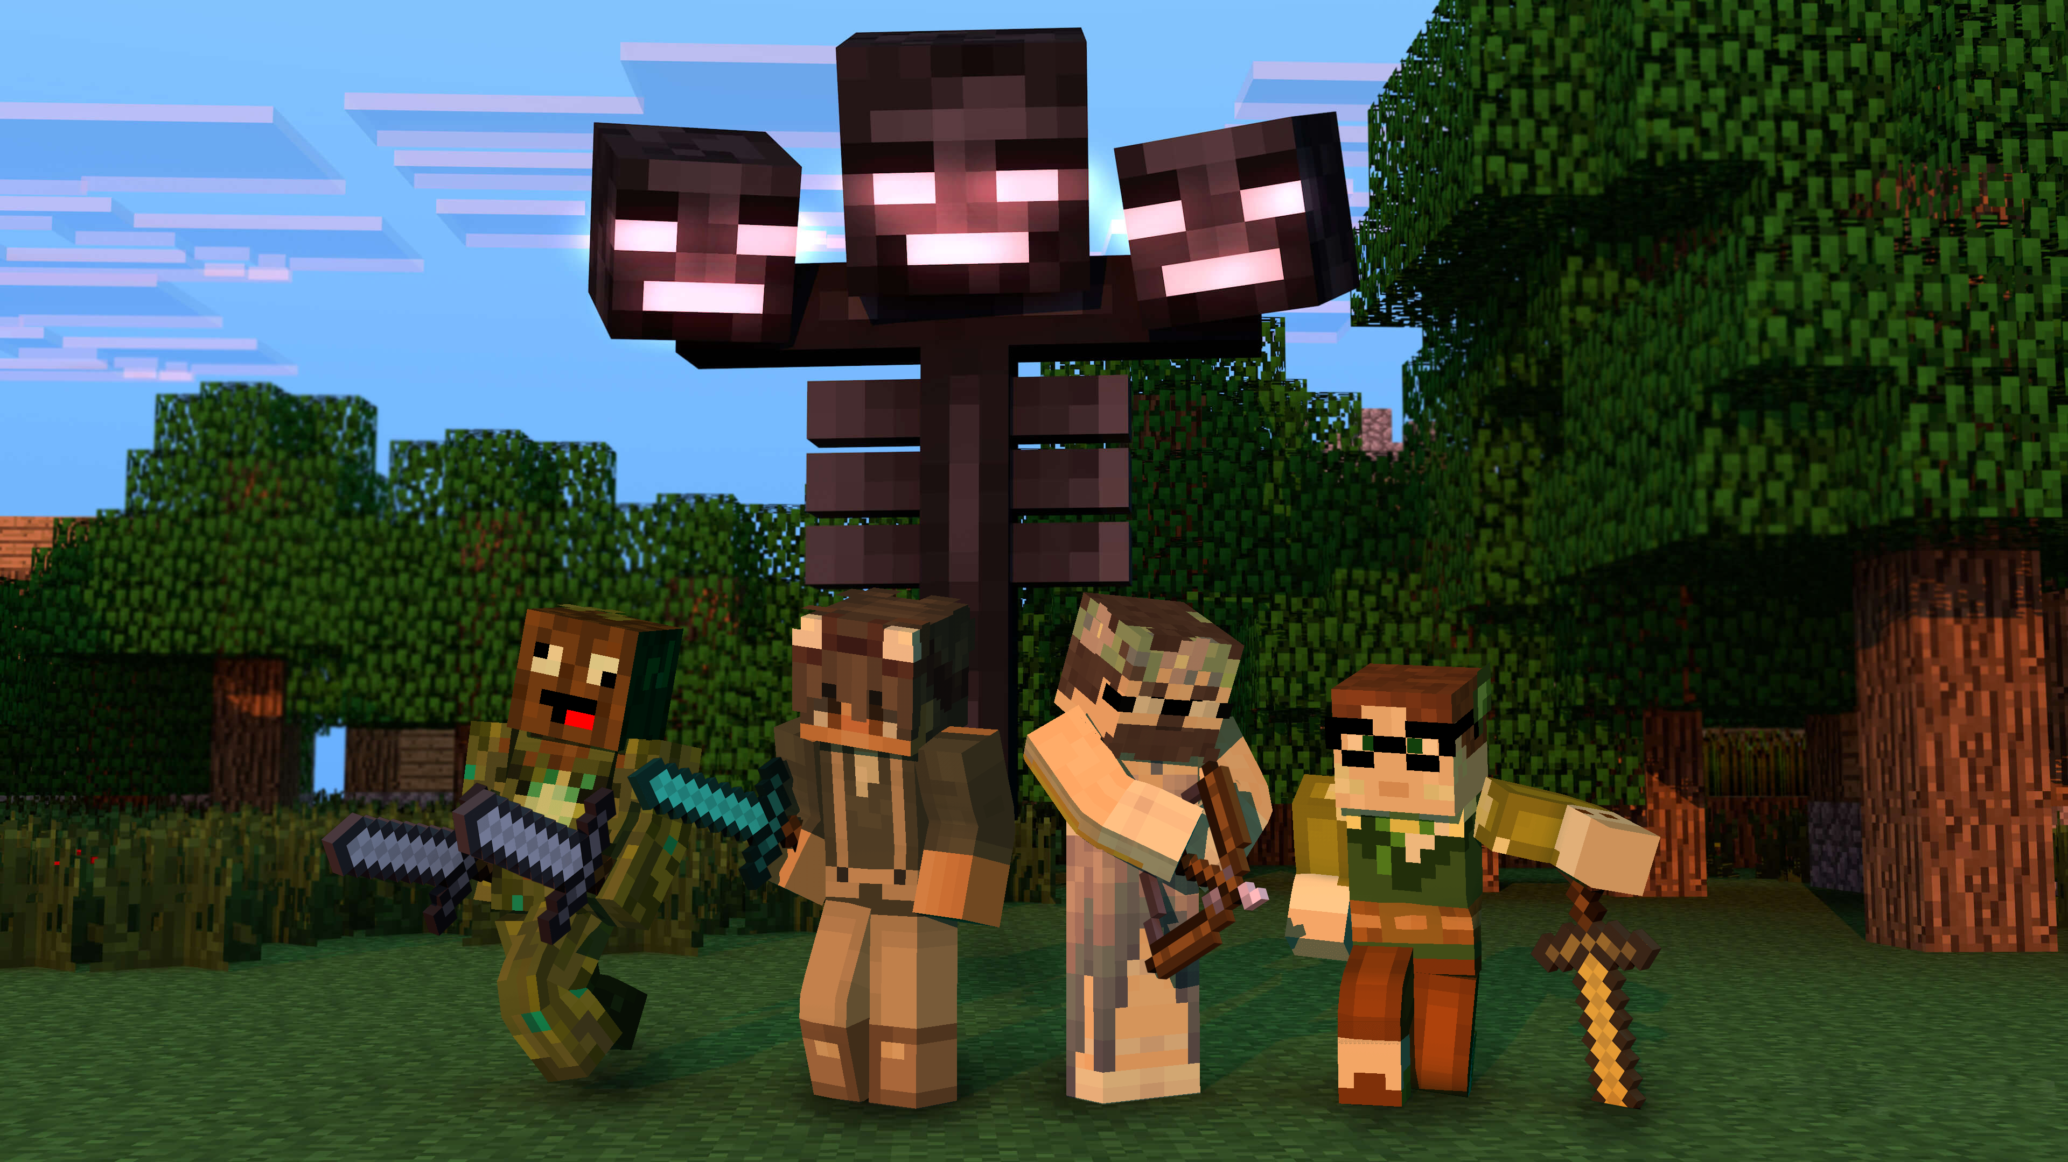


Slide 6
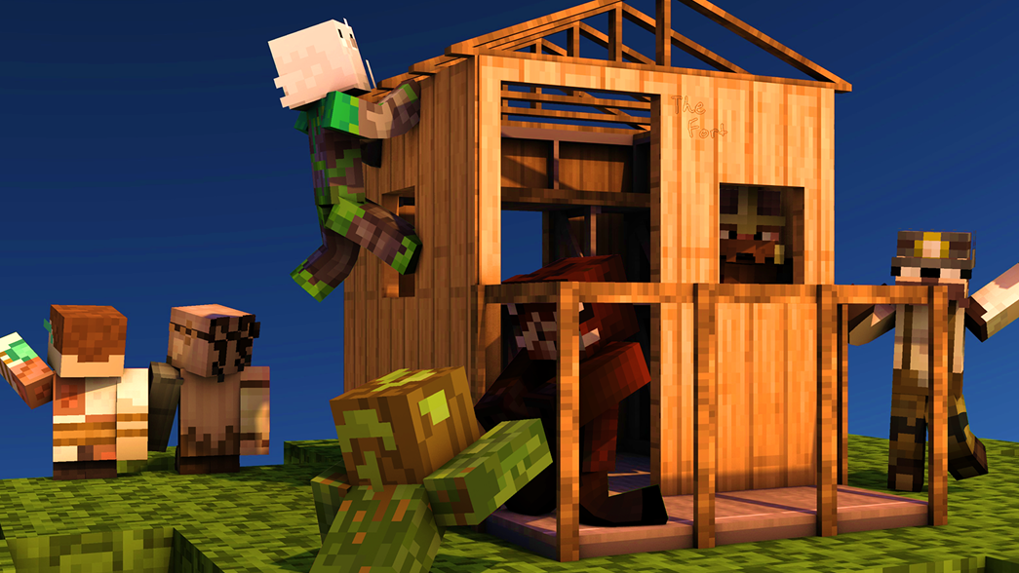


Slide 7


Slide 8



Slide 9



Slide 10
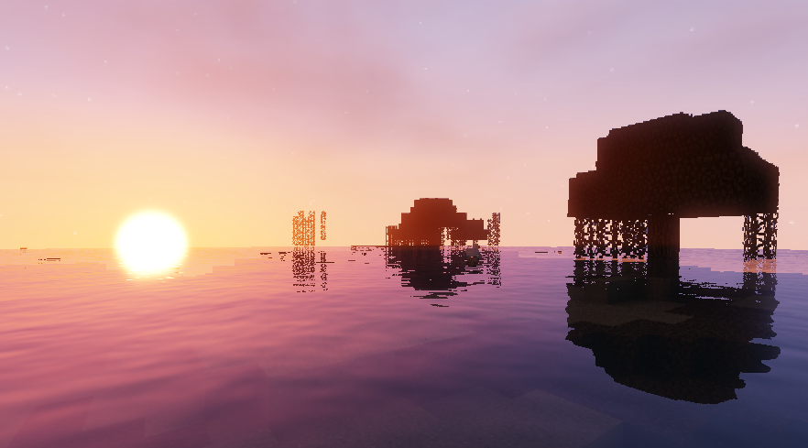


Slide 11
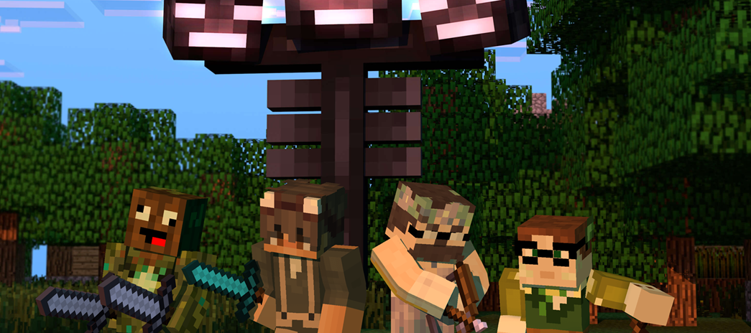
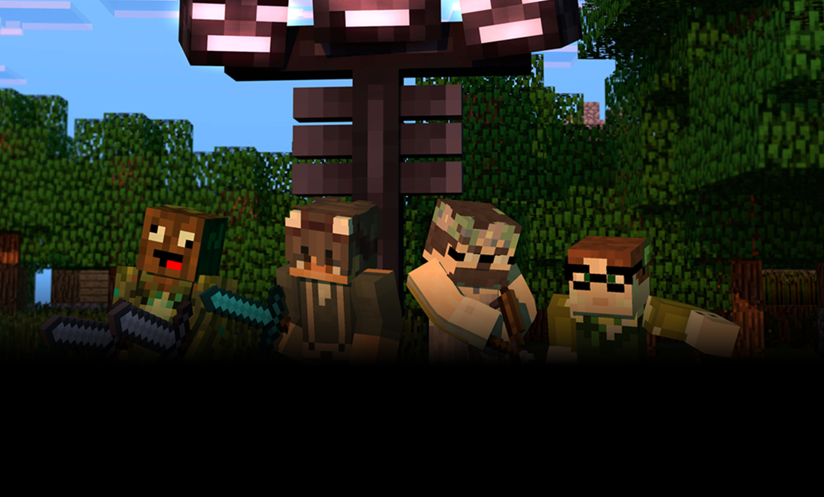

Slide 12
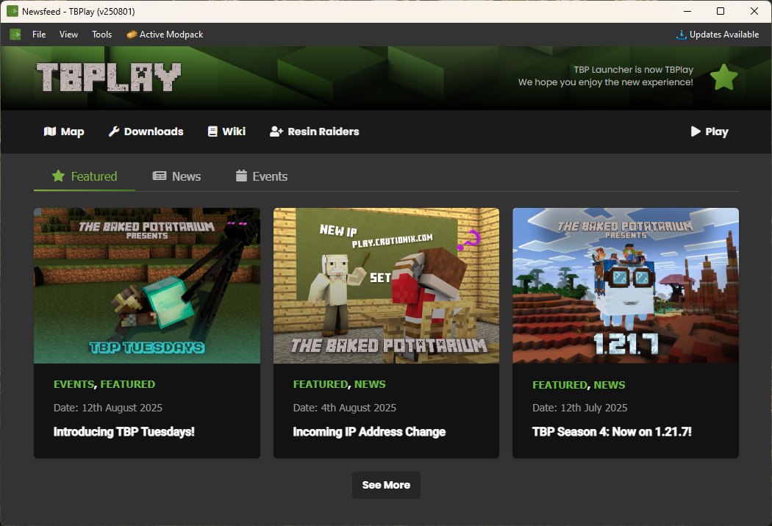
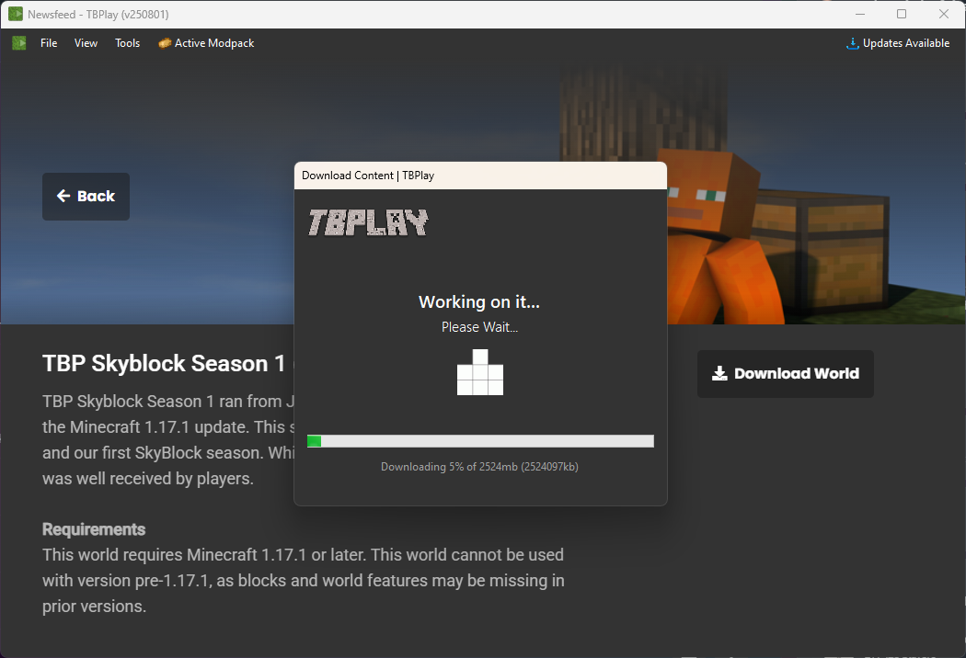

Slide 13
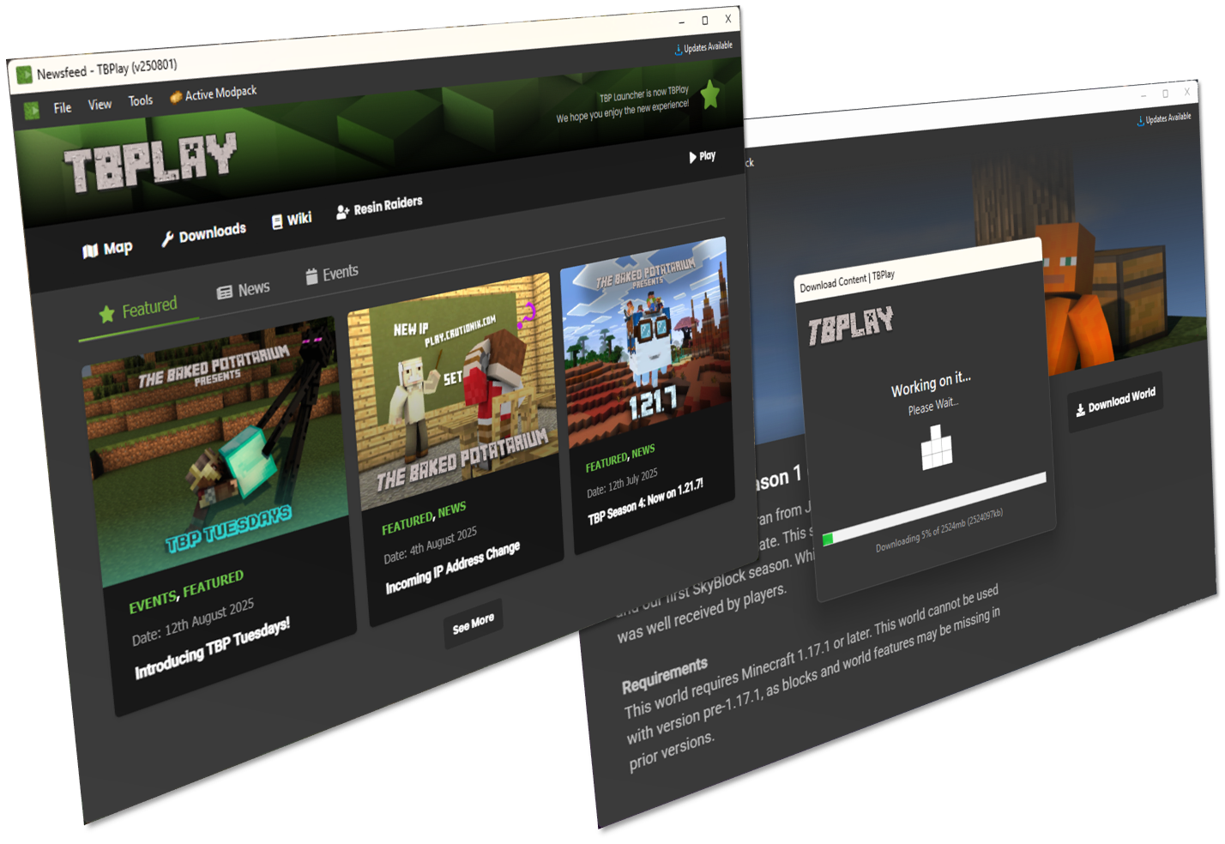


AN UPDATE IS AVAILABLE FOR
Download now for new features, bug fixes and changes, through
Tbplay
Or download manually at
rwe.app/labs/tbp/latest

Slide 14
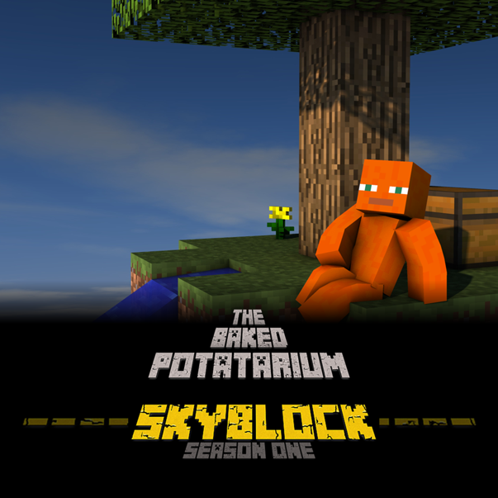


Slide 15






Slide 16
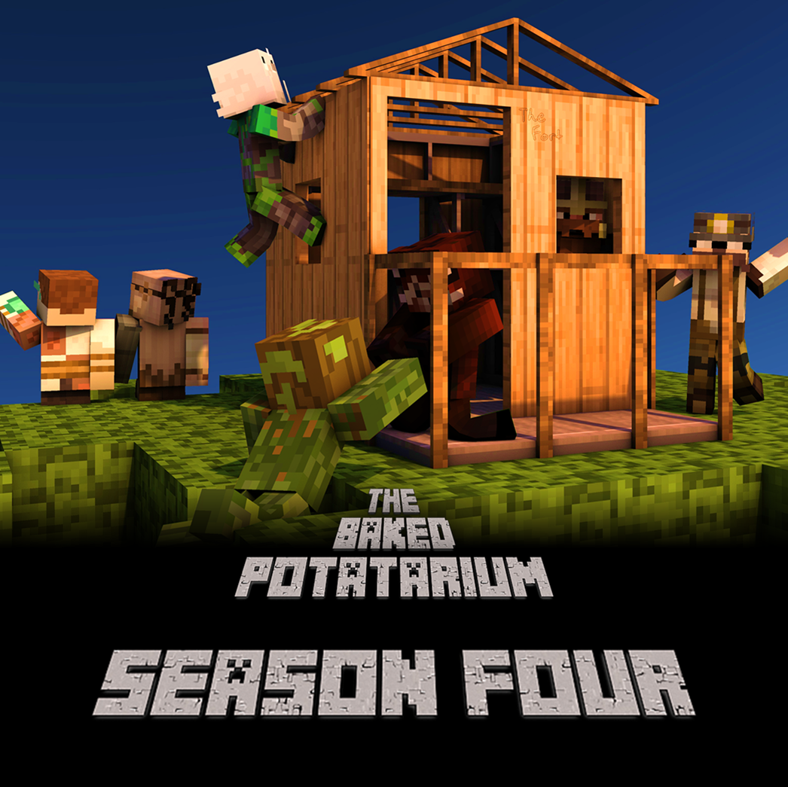
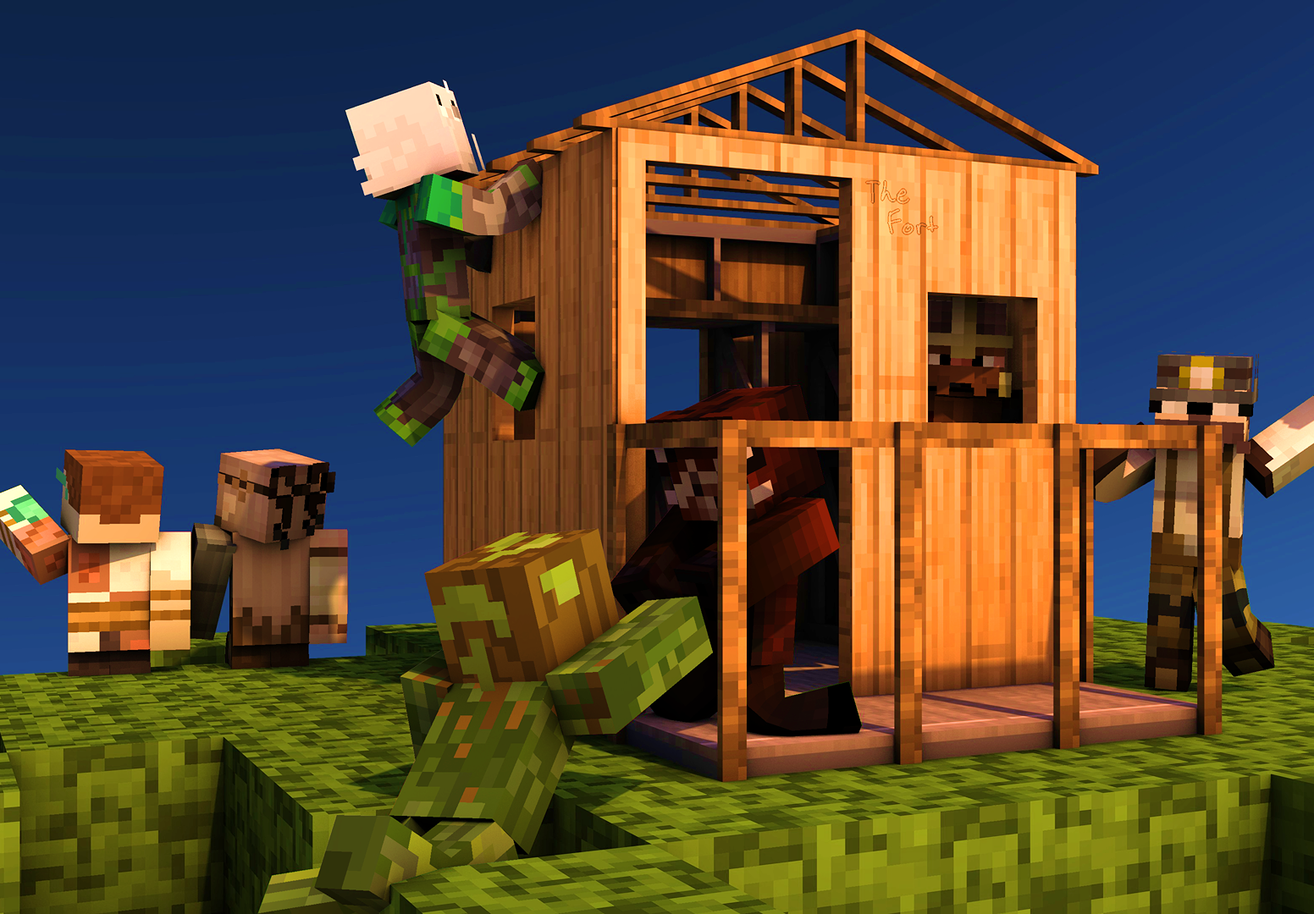


Slide 17
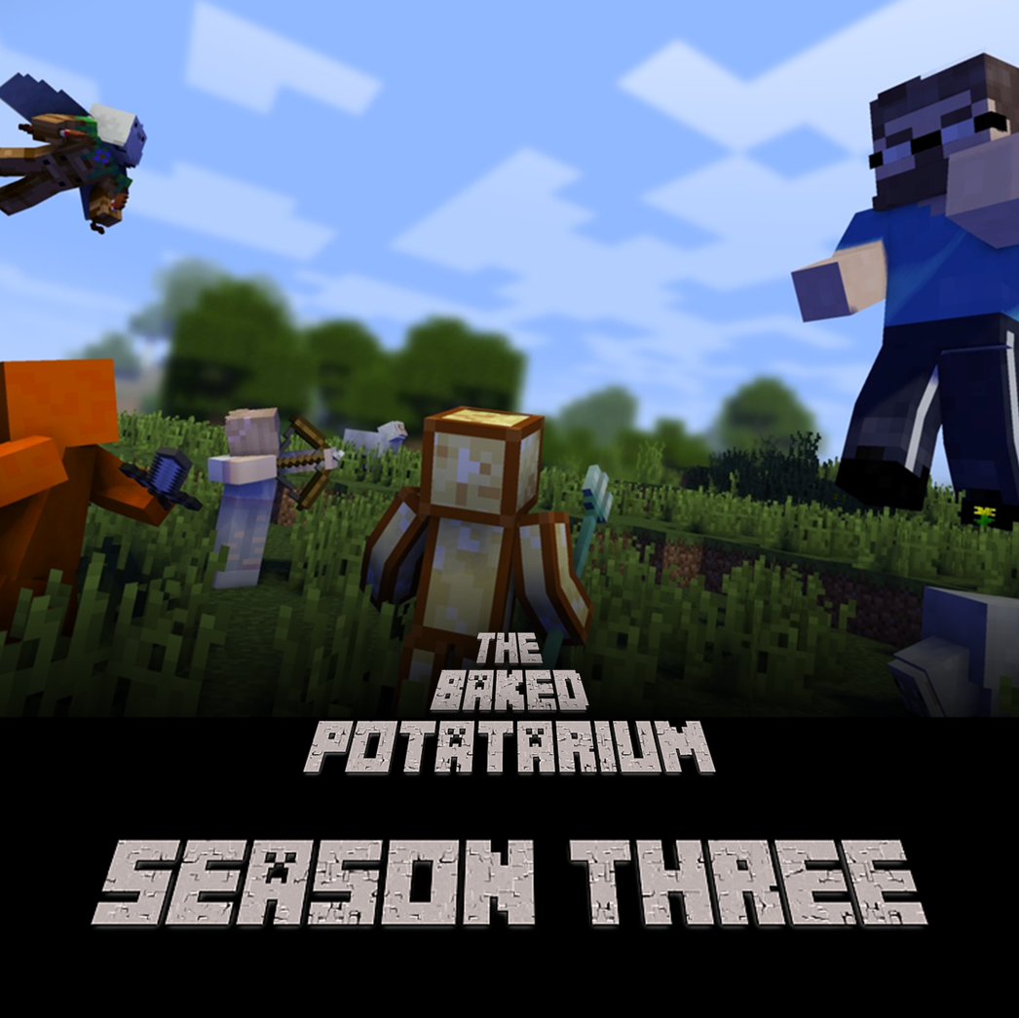
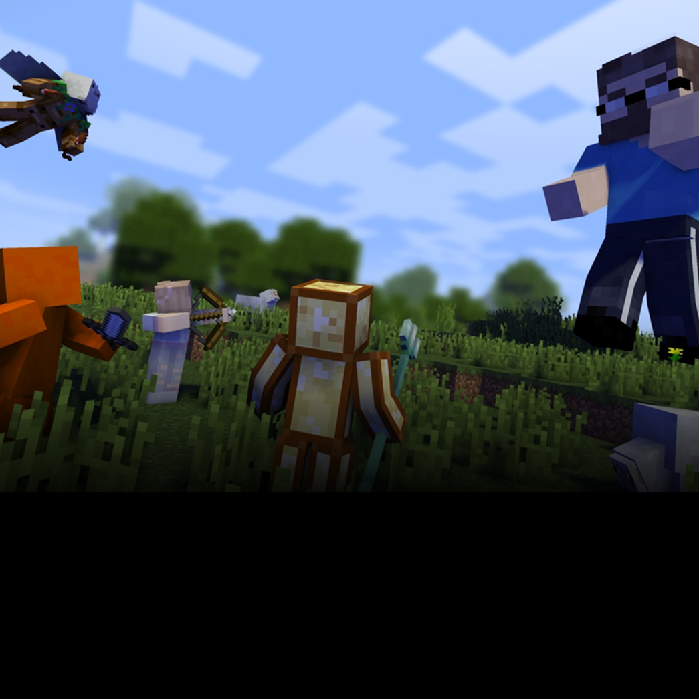


Slide 18




Slide 19

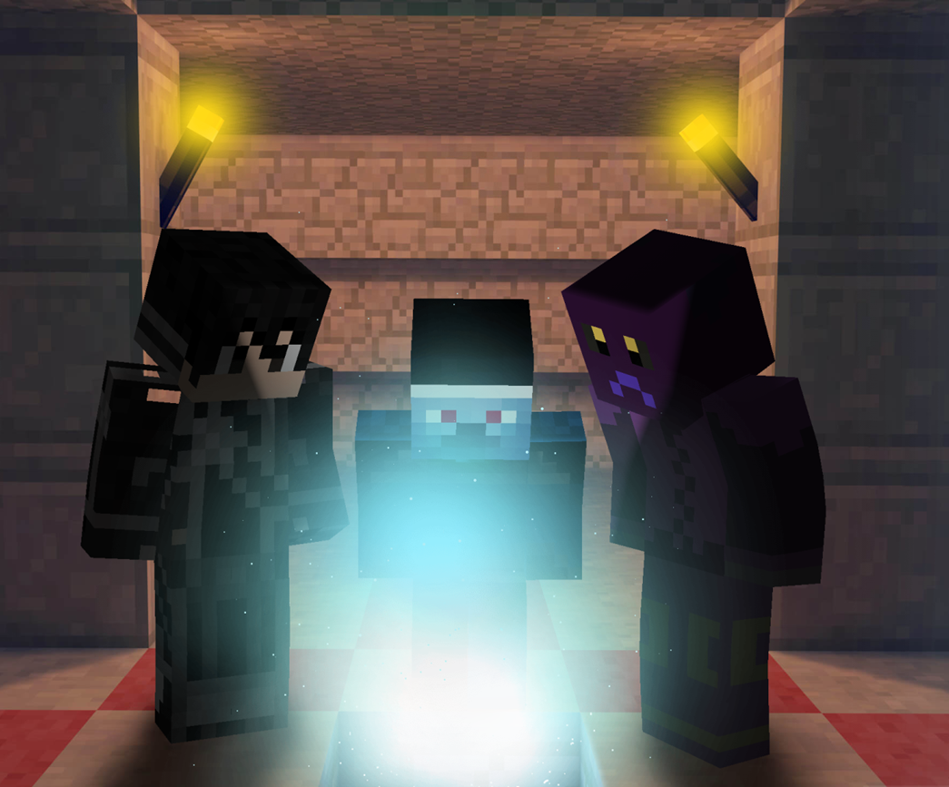

Slide 20
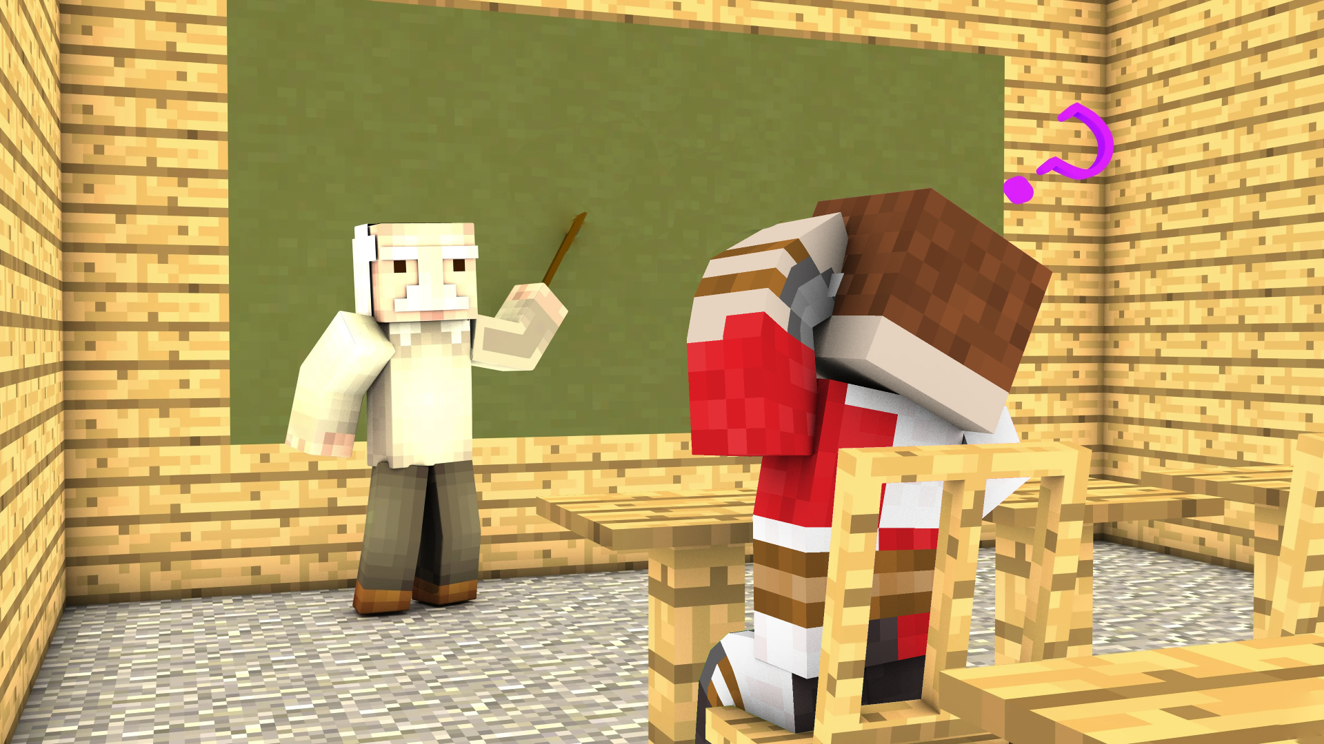
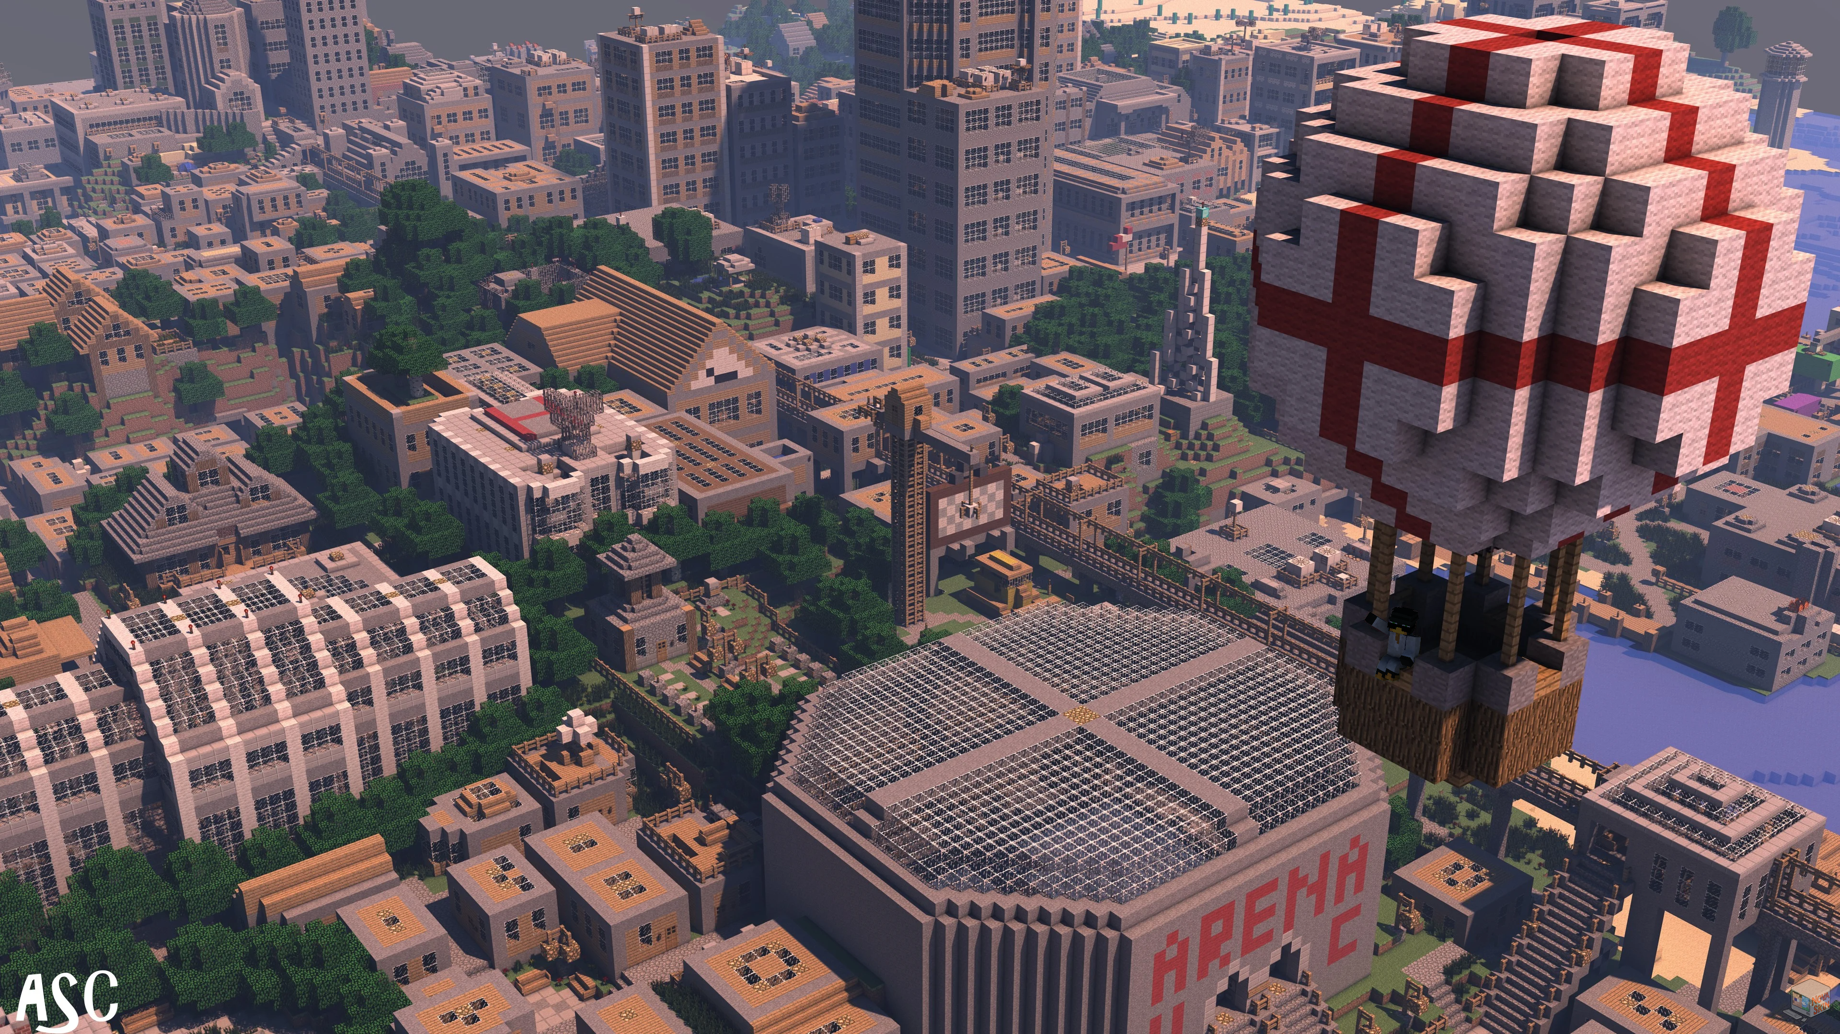
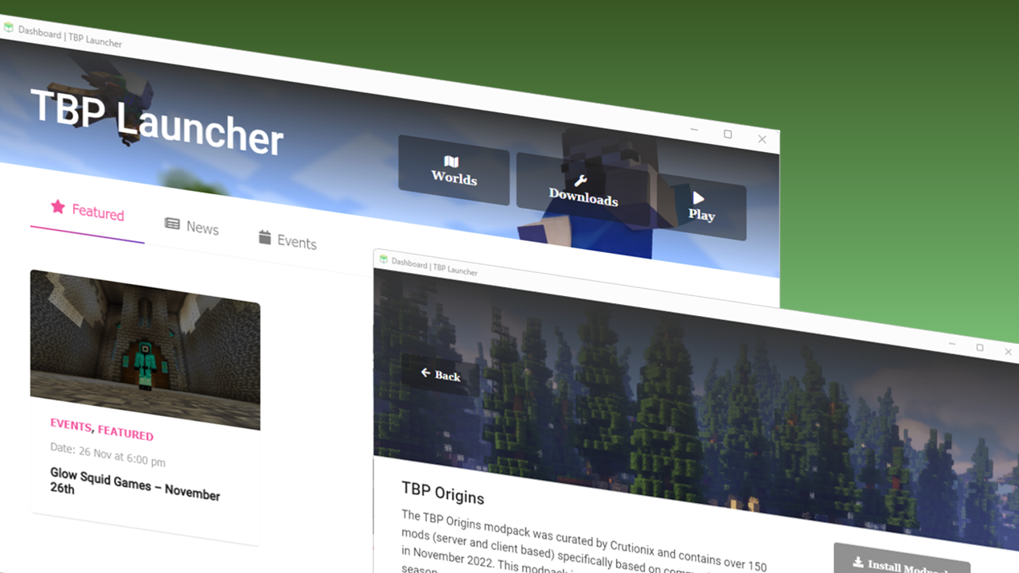
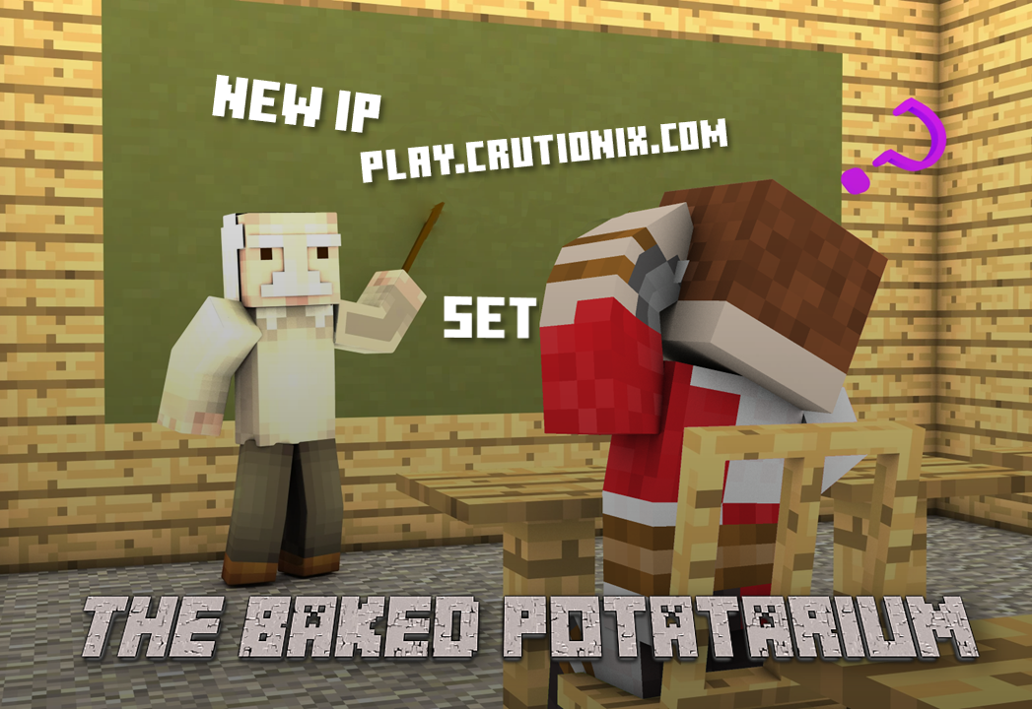

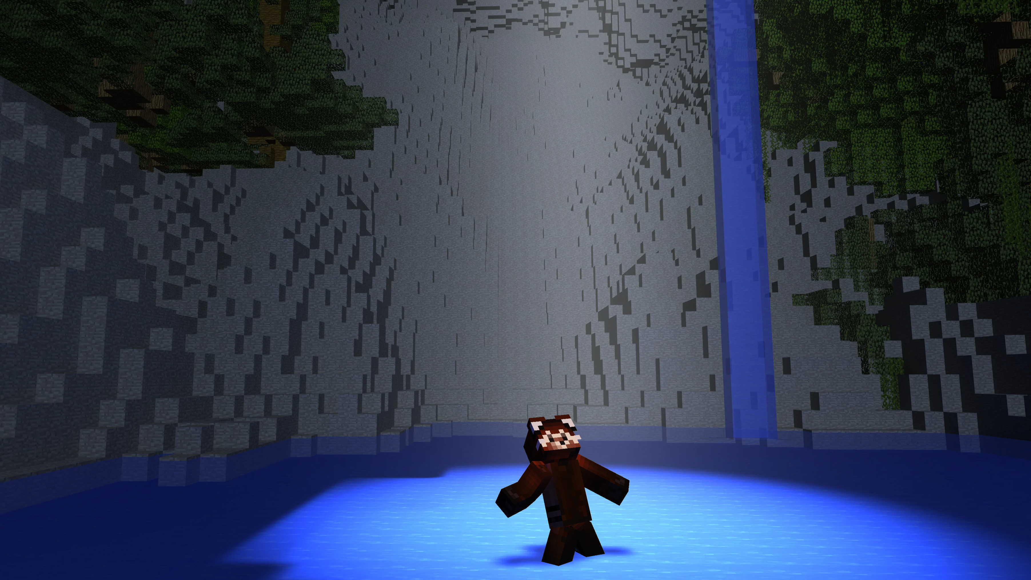
NEW IP
Play.Crutionix.com

Slide 21
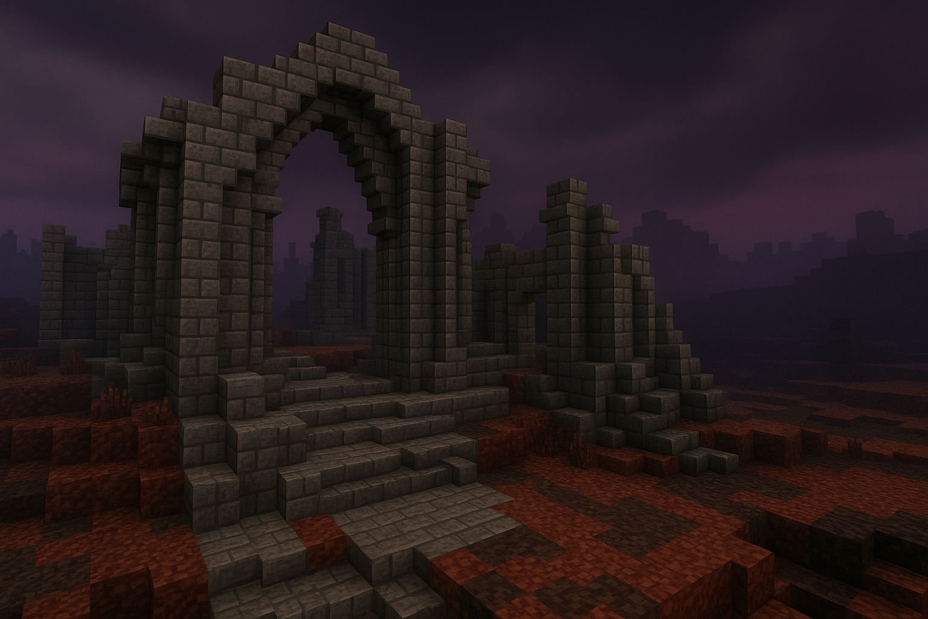
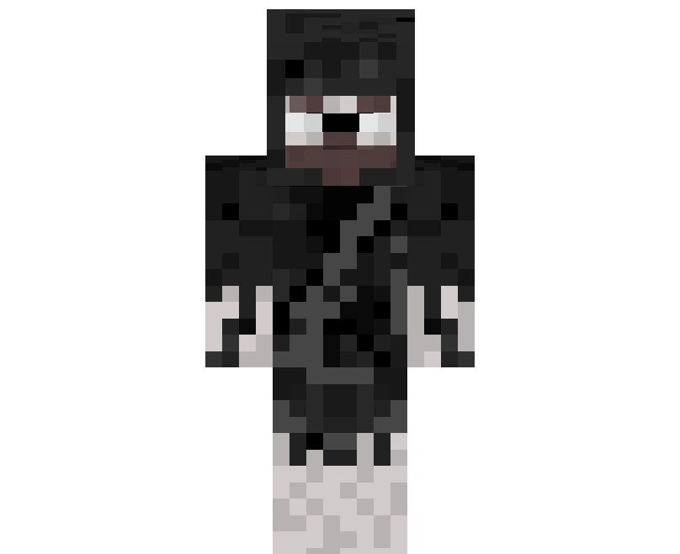
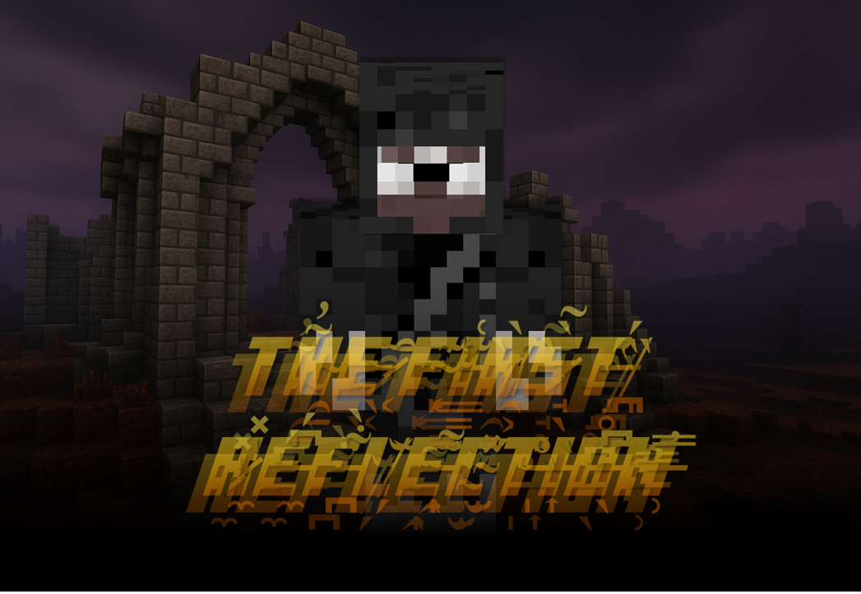
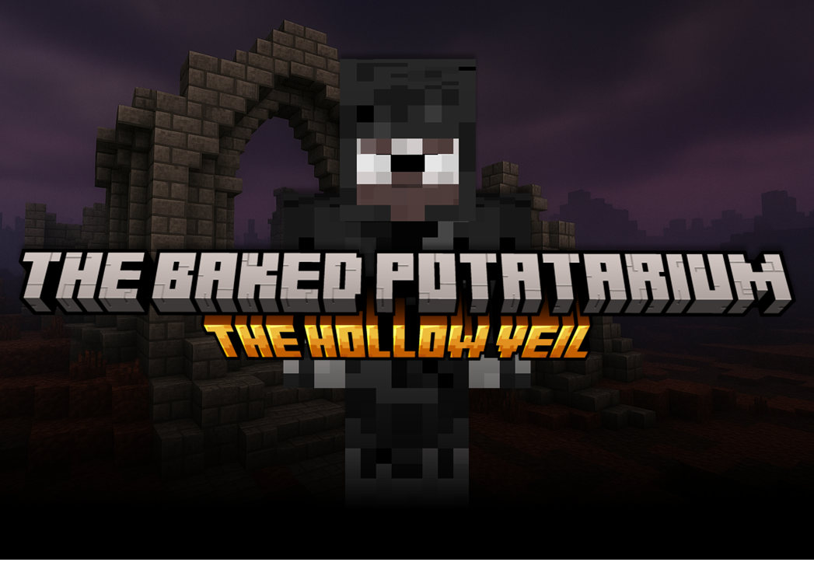


Slide 22



UPDATE AVAILABLE

Slide 23


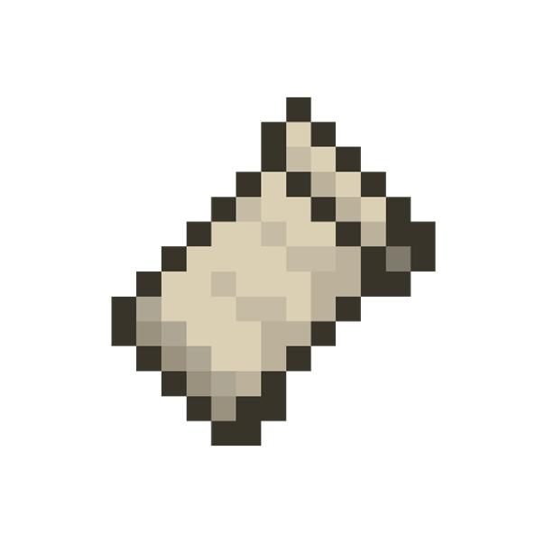


Slide 24
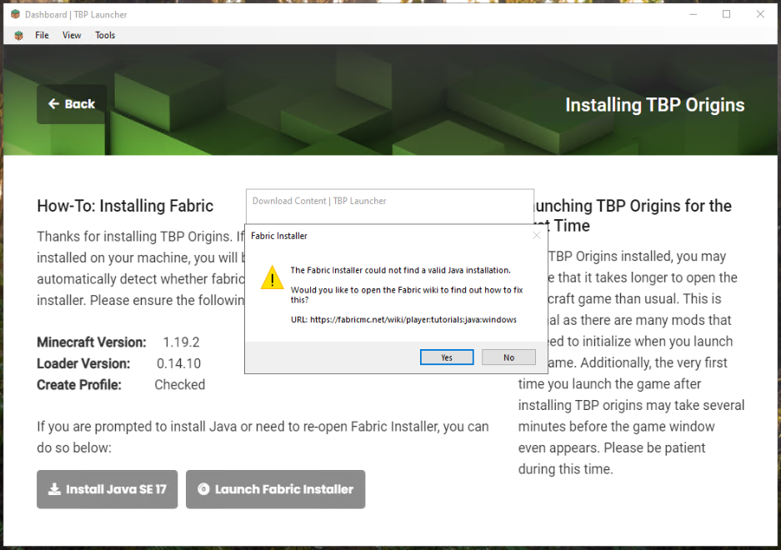
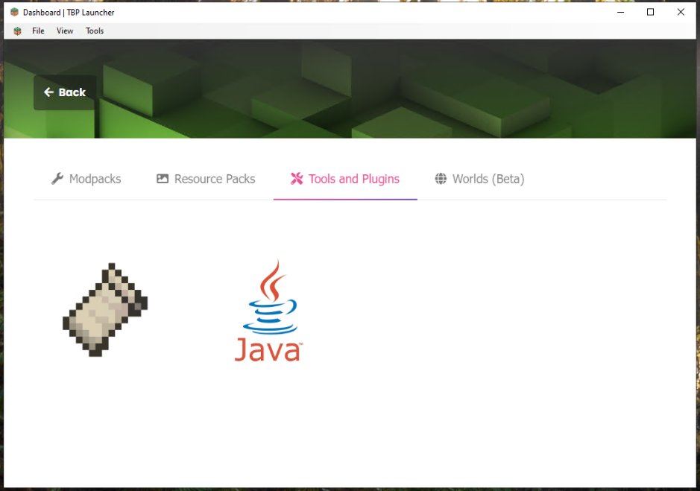
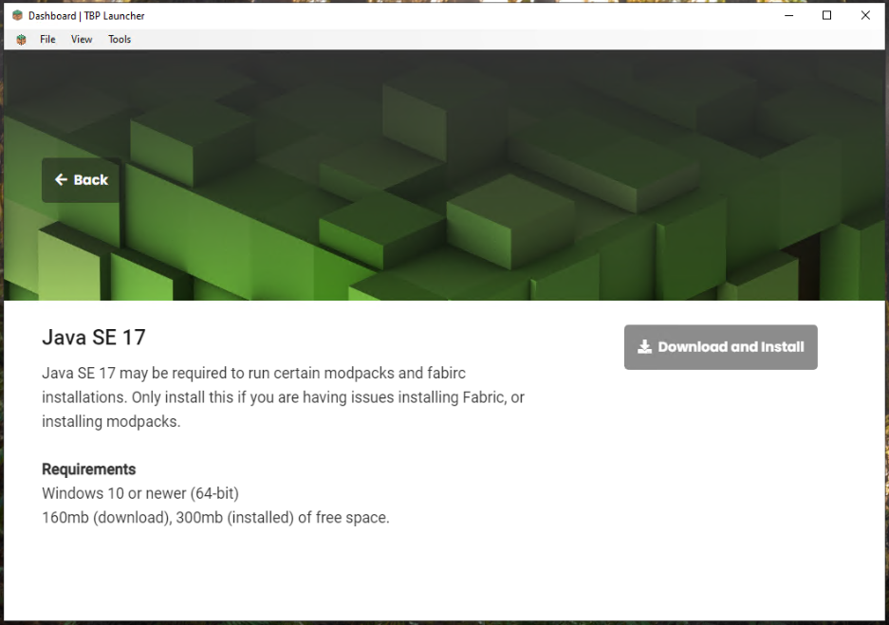
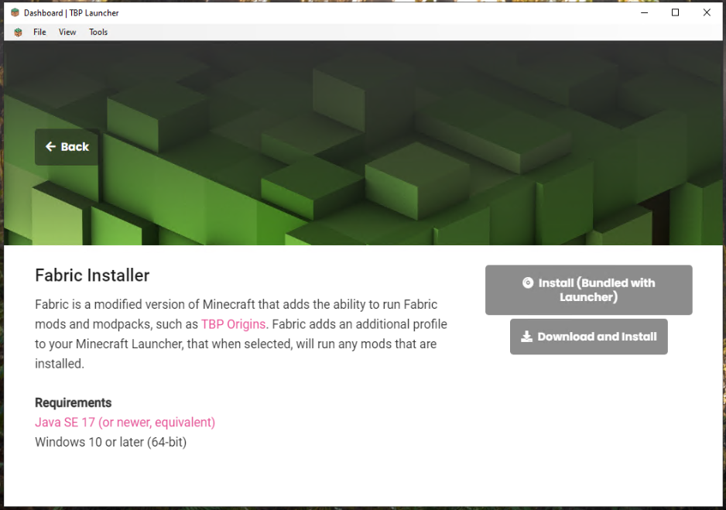

Slide 25

YOU’RE IN
YOU’RE IN
Thank you for registering your interest in TBP: Origins Season 1. We’re pleased to let you know that your whitelist registration has been accepted. Please make sure that you install the TBP Origins mudpack via the TBP Launcher or Crutionix.com. Instructions are available in the Discord. We’re looking forward to seeing you there!
Thank you for registering your interest in TBP: Origins Season 1. We’re pleased to let you know that since you voted yes on the feedback survey, you’re now registered to play. Please make sure that you install the TBP Origins mudpack via the TBP Launcher or Crutionix.com. Instructions are available in the Discord. We’re looking forward to seeing you there!

Slide 26
YOU’RE IN
We’re sorry
Thank you for registering your interest in TBP: Season 4. We’re pleased to let you know that your whitelist application has been approved. Please read the available information in Discord and through the TBP Launcher or Crutionix.com.
We’re looking forward to seeing you there!
Unfortunately, this time around your whitelist application has been denied.
Please read the reason provided in this ticket. If you have any follow up questions regarding the denial of your application, please ask them within this ticket and a moderator will get back to you as soon as possible.

Slide 27
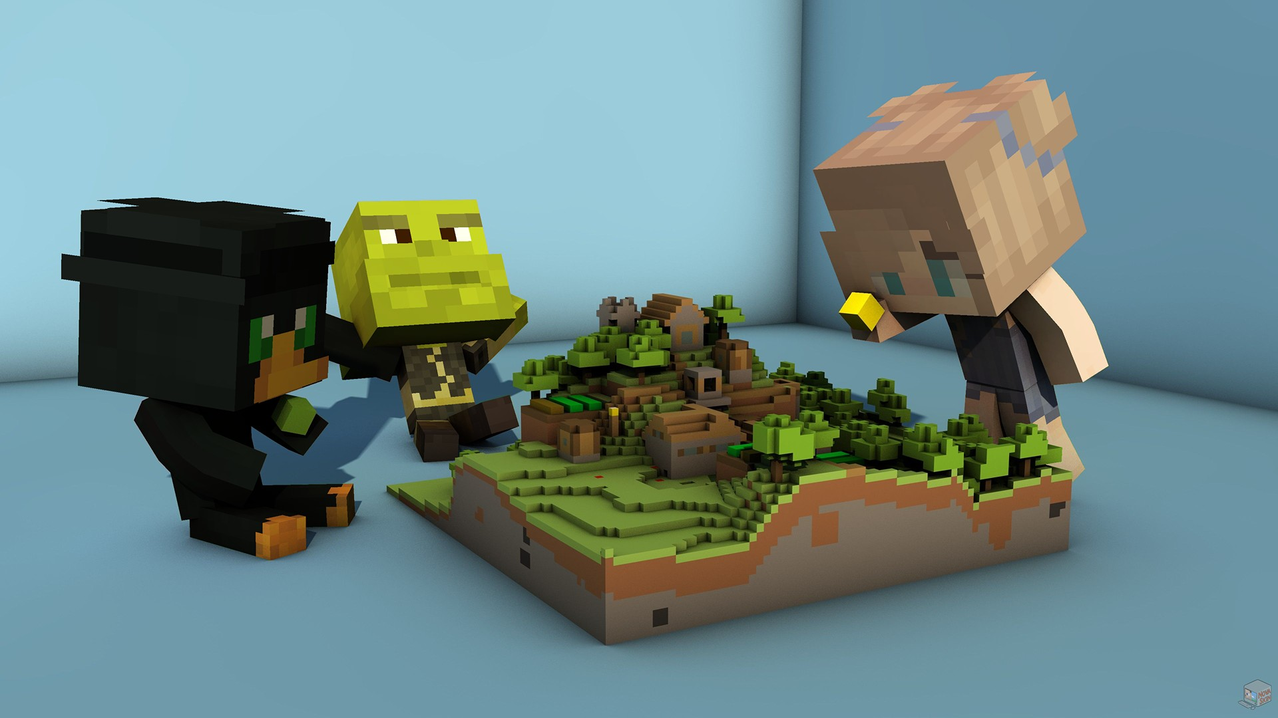

Slide 28
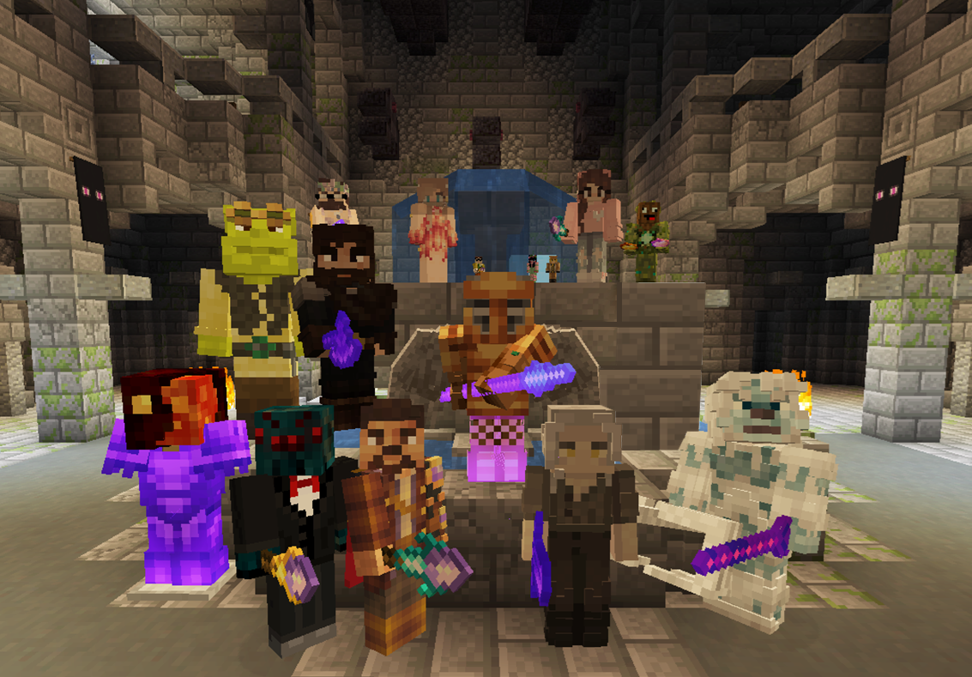


Slide 29
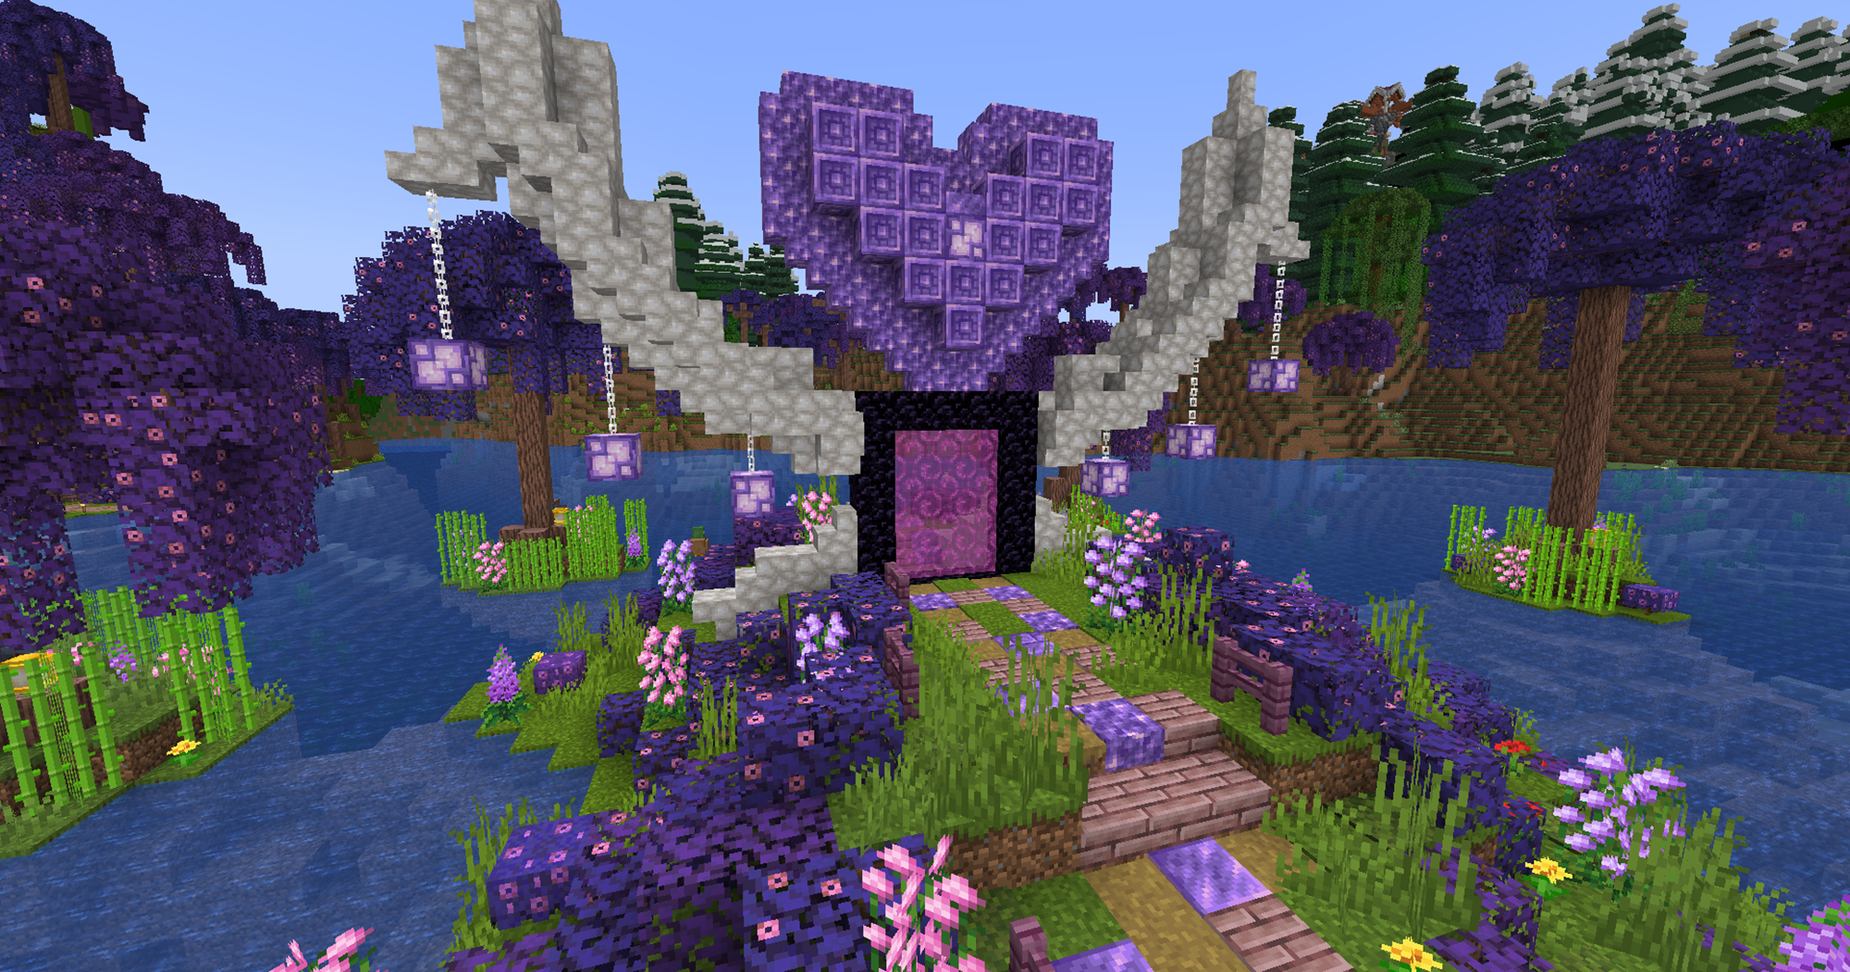
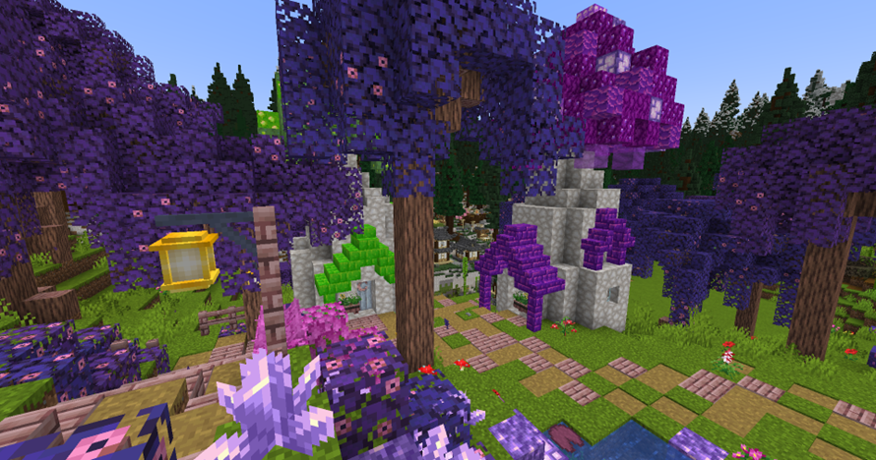
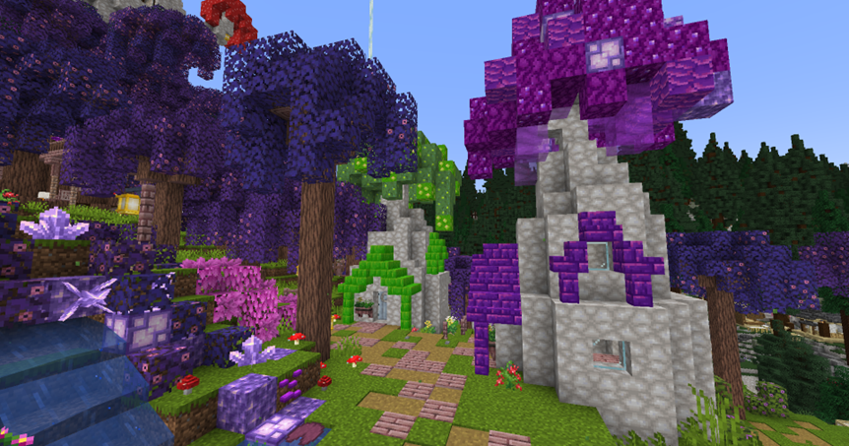
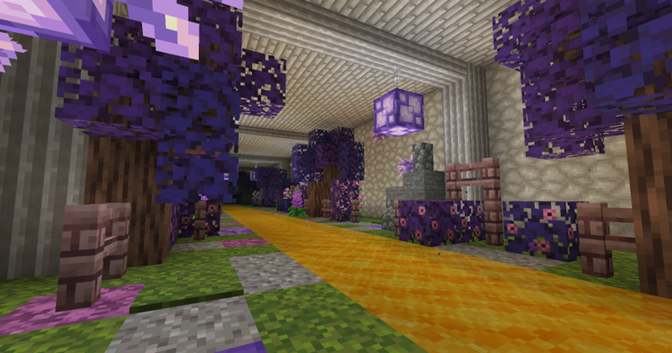

Slide 30

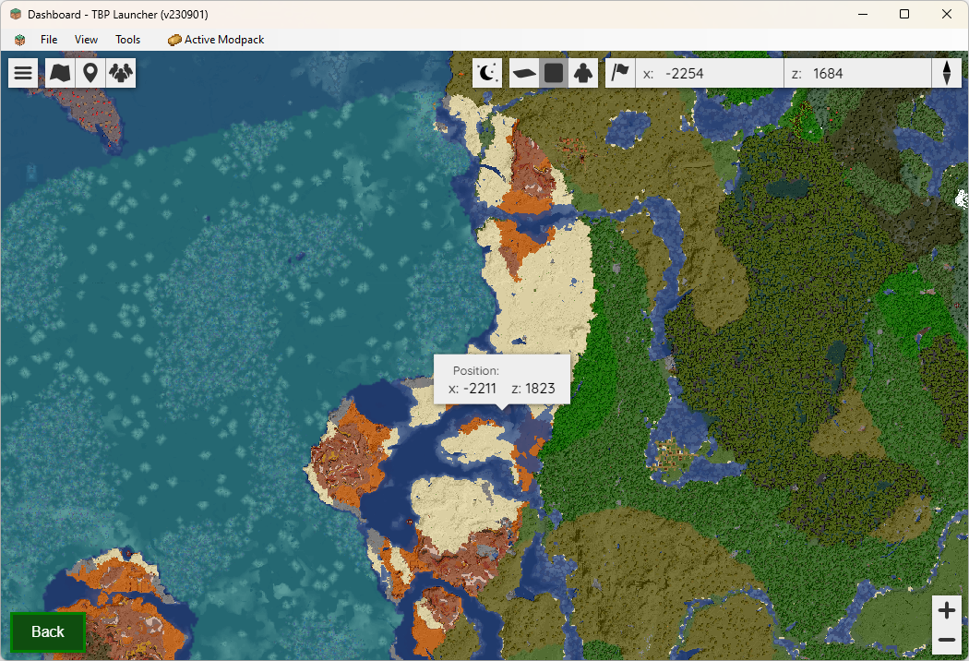
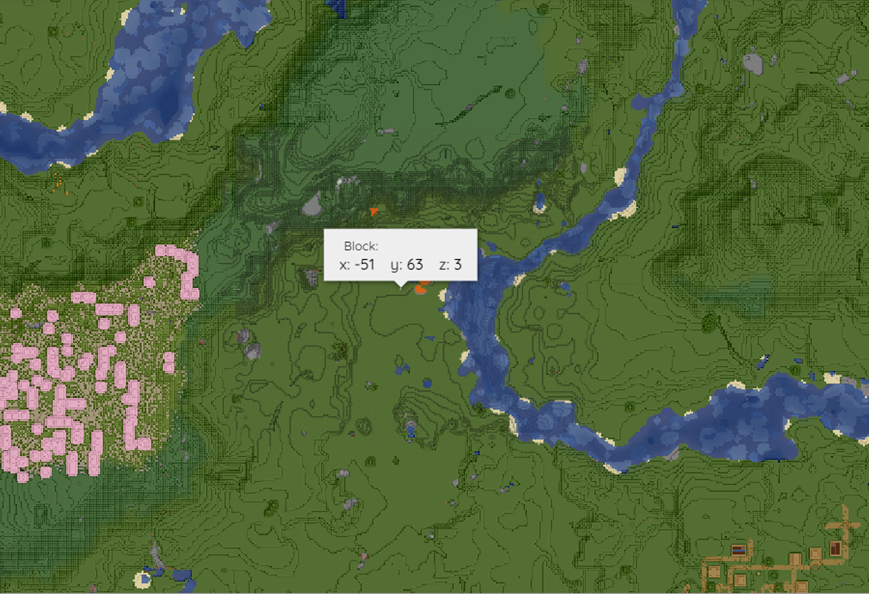
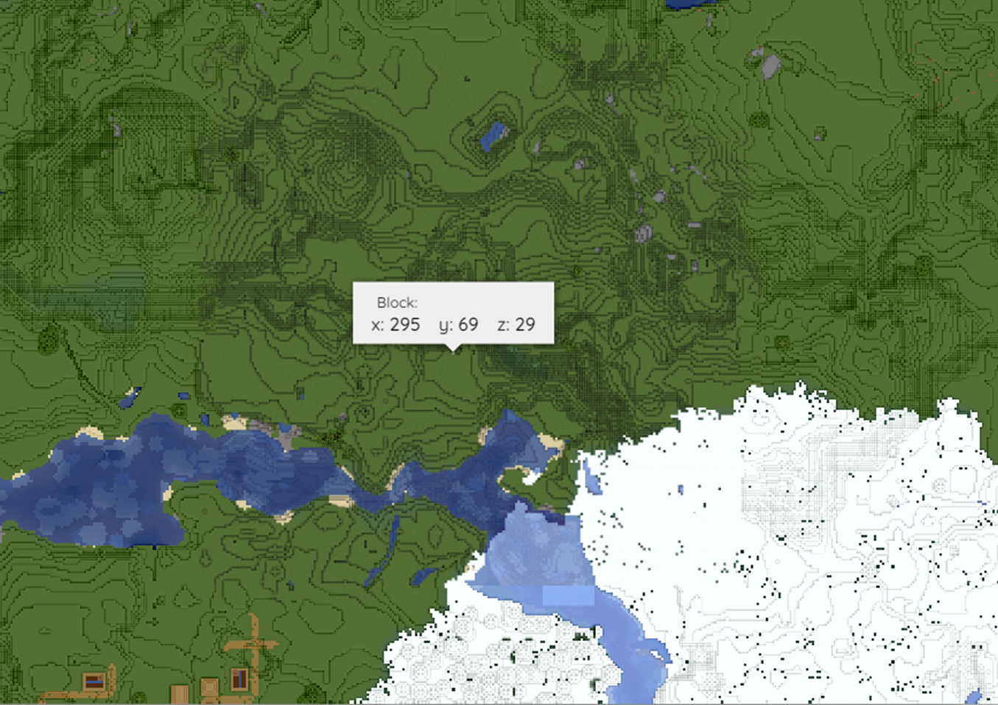

RESOURCE BIOMES
spawn
Cave dwellers
-2211 1823
-51 3
295 29

